Slide 1

ॐ श्रीगणेश-शारदा-गुरुभ्यो नमः॥ CS698F Mid-Demo
TEAM 1:
ASHWIN SHENAI (180156)
ISHANH MISRA (180313)

Slide 2
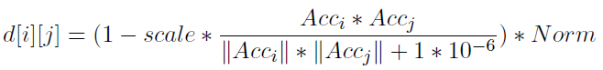
Gesture Recognition
Basic DTW implemented for recognizing simple gestures.
Decision for “Distance” metric d(x_{i}, y_{j}):
One is simple Euclidean distance: d(x_{i}, y_{j}) := (x_{i} - y_{j})²
Other is Cosine Similarity Metric:
Simple gestures include (for now):
Hand going forward/backward, making a cross and a wave.
In future: will include up/down, right/left, rotational hand movement, etc.

Slide 3
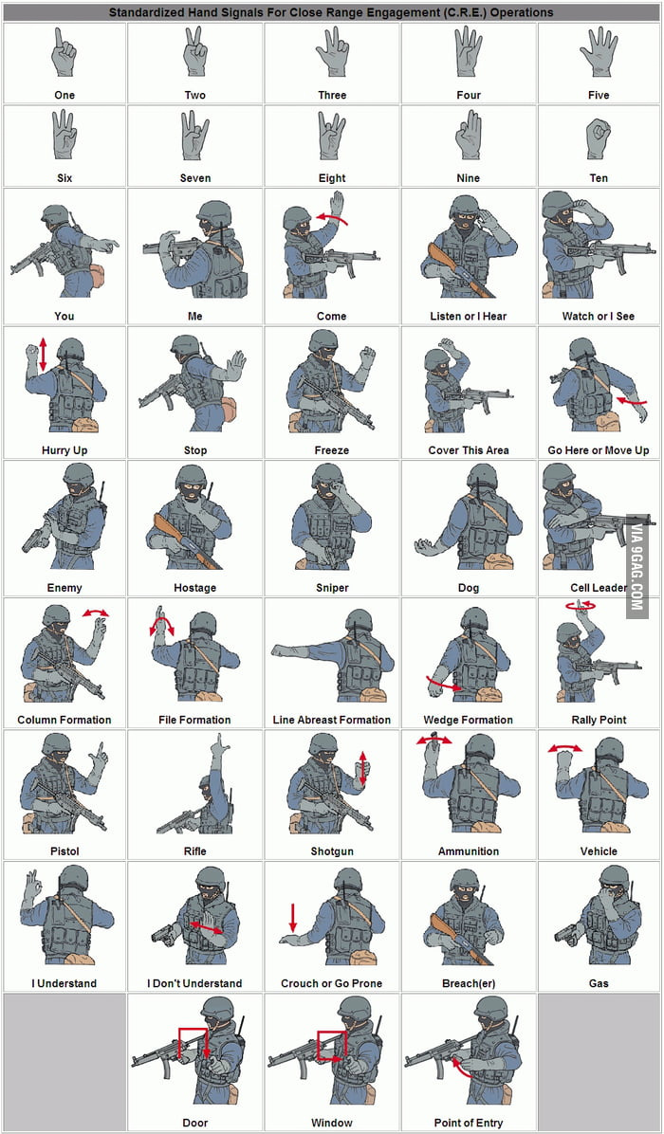
Gesture Recognition
More complicated gestures are possible. Not covering them for now.

Slide 4
Data Collection
Used Physics Toolbox to collect accelerometer data for the following gestures:
Forward
Backward
Wave
Cross
Gestures were recorded at low speed – each gesture spans about 5 seconds
Data was recorded at minimum possible sampling rate – 100 Hz frequency

Slide 5
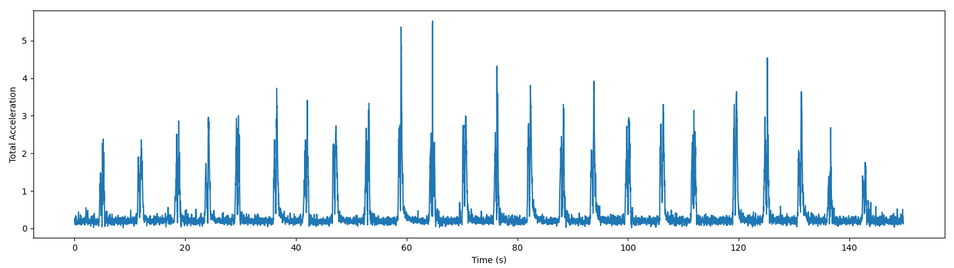
Data: Forward / Backward

Slide 6
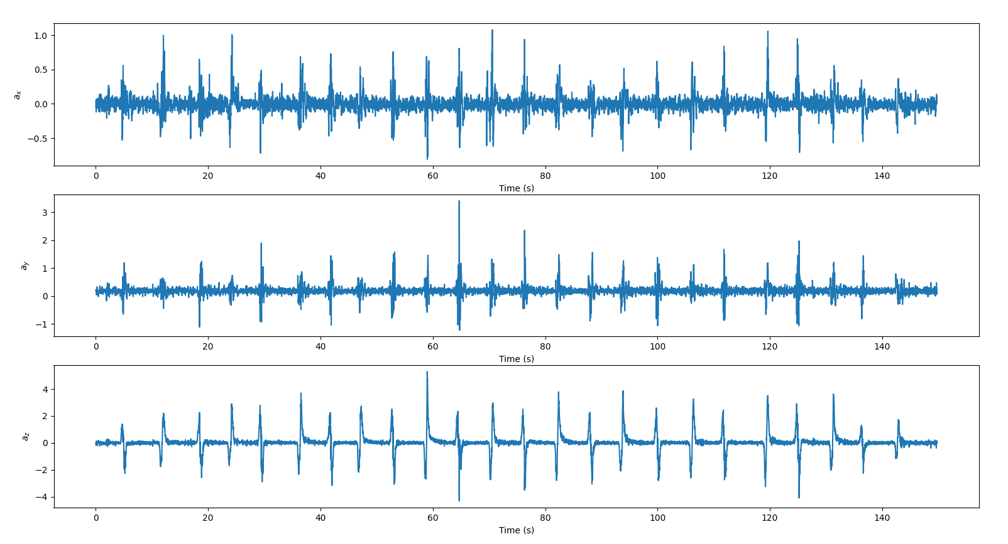

Slide 7
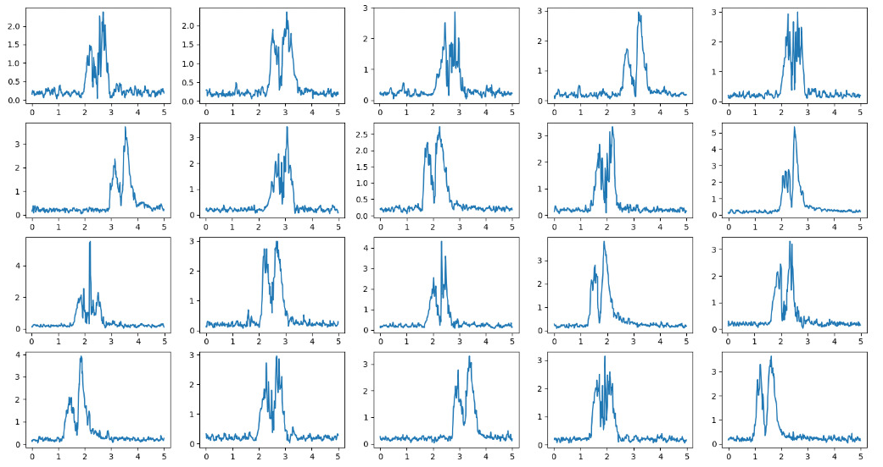

Slide 8
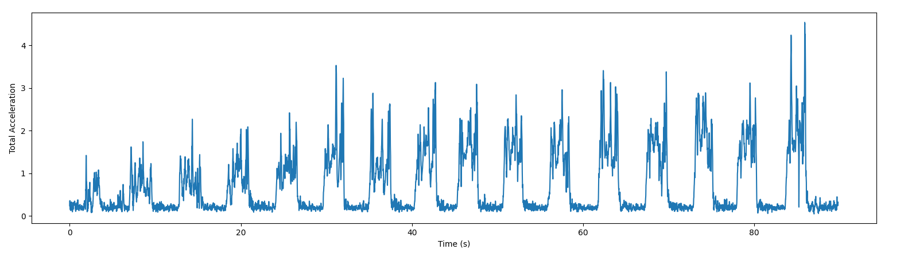
Data: Wave

Slide 9
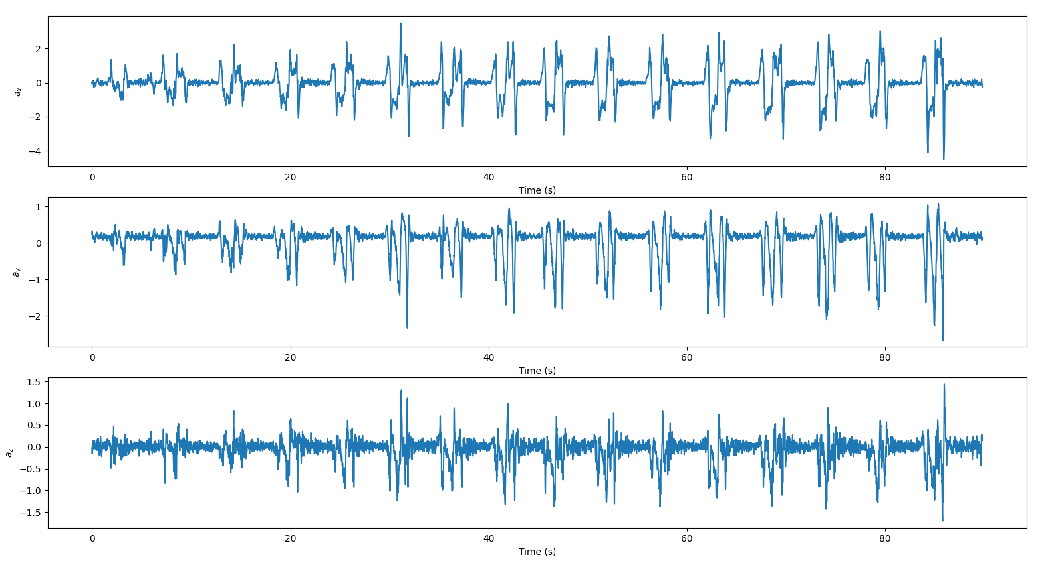

Slide 10
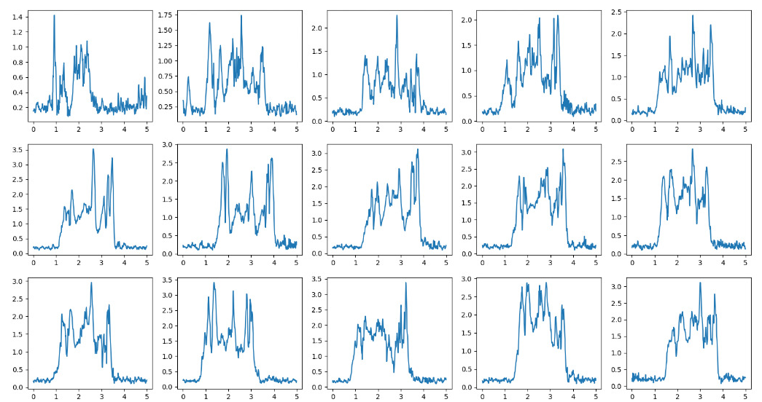

Slide 11
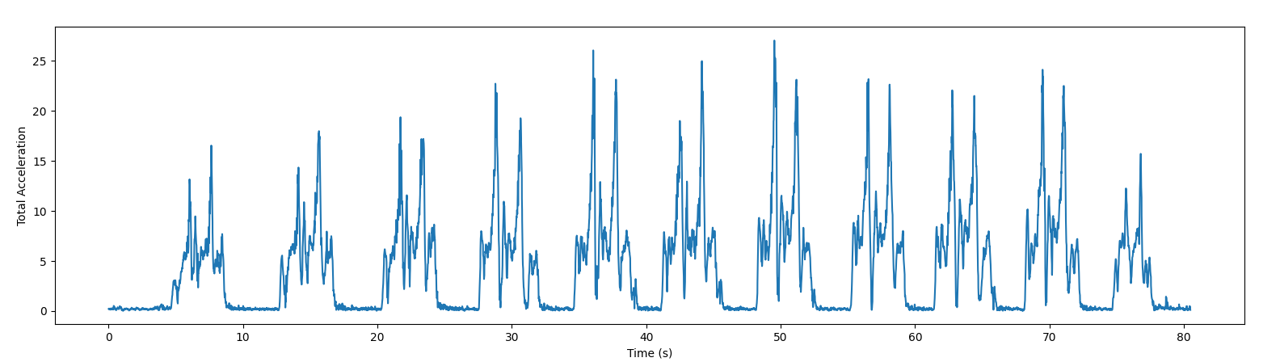
Data: Cross

Slide 12
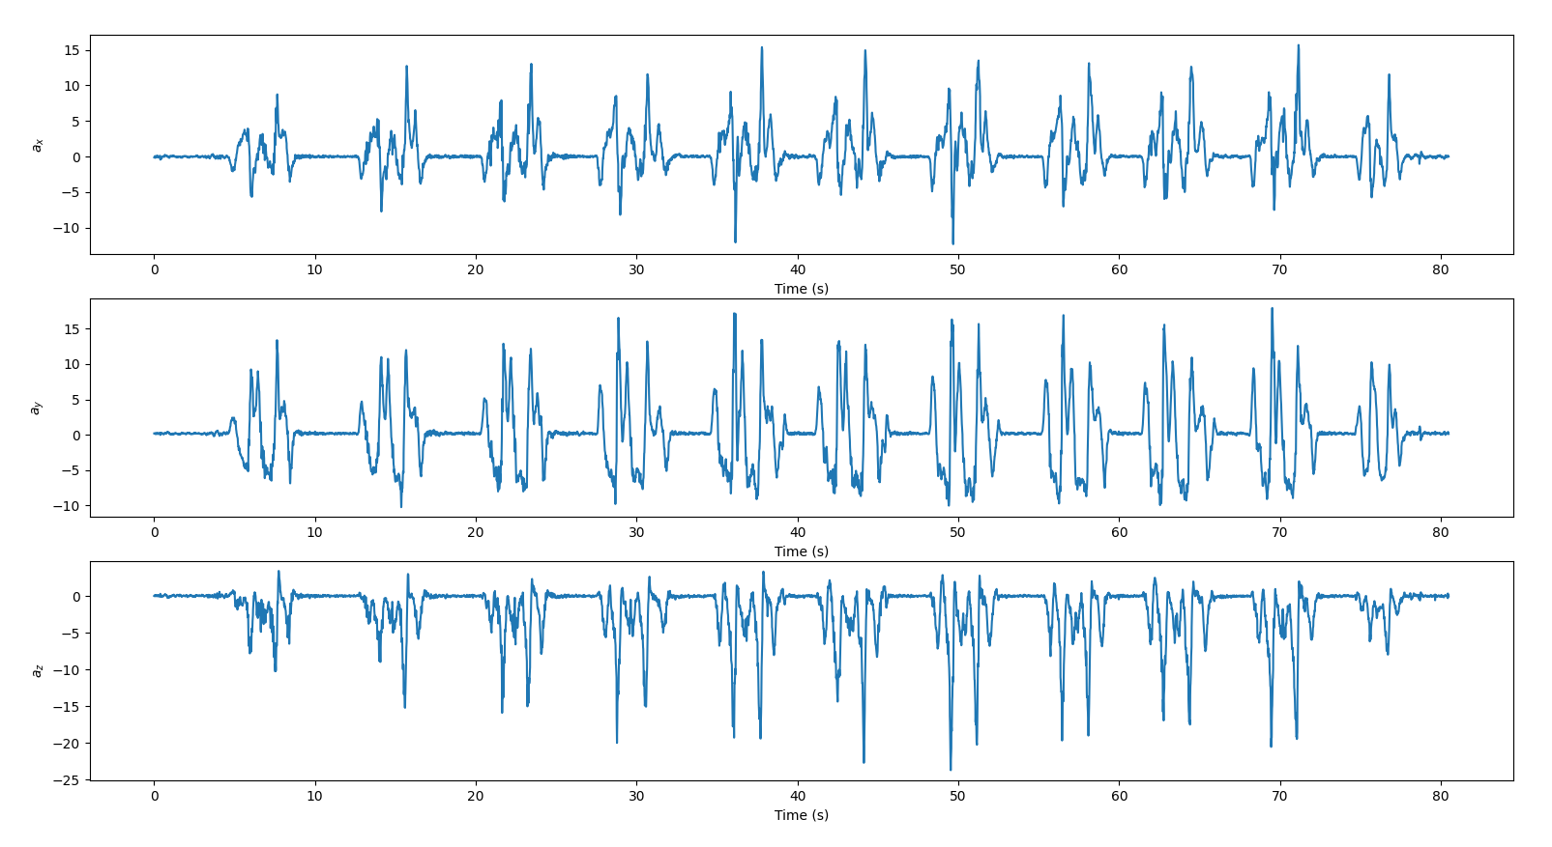

Slide 13
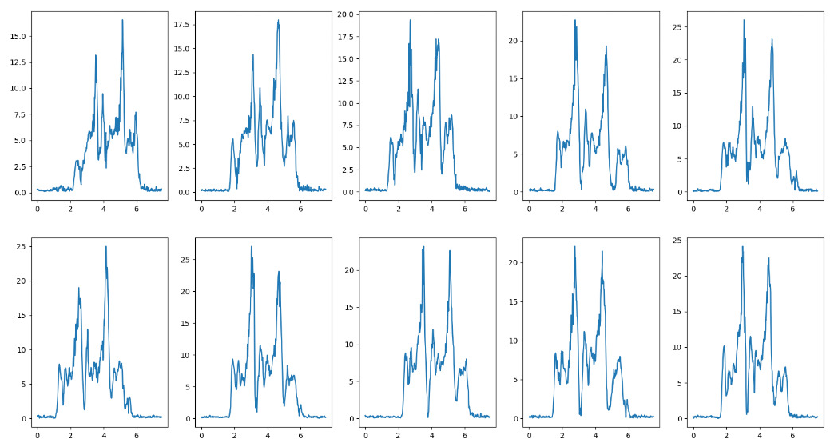

Slide 14
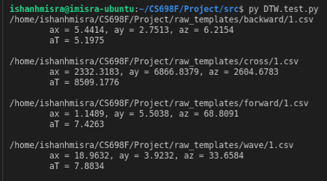
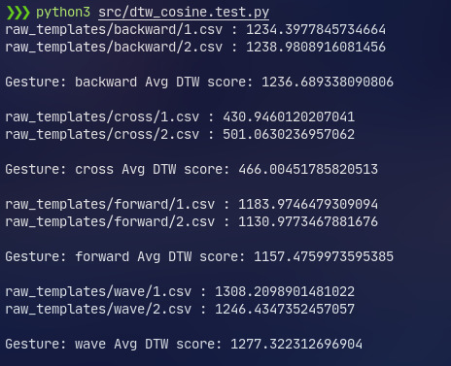
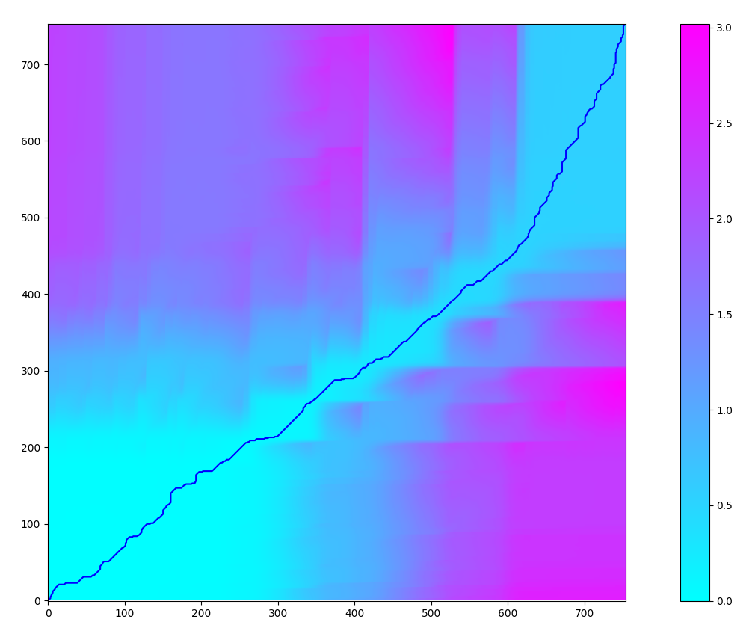
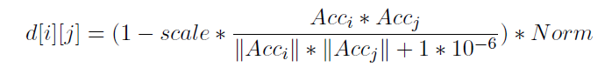
DTW Executions
Euclidean Metric
Cosine Similarity Metric
DTW path (matching signal) from Cosine Metric

Slide 15
DEMO

Slide 16
Future Work
As suggested in original paper, smoothing out signals yet to be done before DTW.
Experiment with downsampling data to decrease dimensionality and increase speed
Collecting gyroscope samples for rotational movements.
Trying estimating stroke lengths (can’t say for sure).
Another paper that uses Neural Networks based approach:
Kim M, Cho J, Lee S, Jung Y. IMU Sensor-Based Hand Gesture Recognition for Human-Machine Interfaces. Sensors. 2019; 19(18):3827. https://doi.org/10.3390/s19183827
Says DTW is complex for real-time learning. Introduces a Restricted Column Energy (RCE) neural network.
Neurons activated only when necessary. 98.6% accuracy on FPGA (150 MHz).

Slide 17
Future Work
Trying to generate a user-agnostic template for each gesture
Matching multiple gestures in an online fashion
Some good libraries also found:
StumPy: https://stumpy.readthedocs.io/en/latest/index.html
FastDTW: https://github.com/slaypni/fastdtw
Motif Tracking Algorithm (Pattern Recognition):
Wilson, W., Birkin, P. & Aickelin, U. The motif tracking algorithm. Int. J. Autom. Comput. 5, 32–44 (2008). https://doi.org/10.1007/s11633-008-0032-0 (https://arxiv.org/ftp/arxiv/papers/1006/1006.1526.pdf)
Mainly intended for financial/economic data (for example, Oil prices).
But can apply to general signals as well.
Will see if time permits.

